Slide 1



PlainApp
By
Muzammil - Azaan - Mufeez - Uzair
BCS 2J

Slide 2
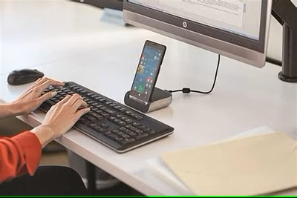
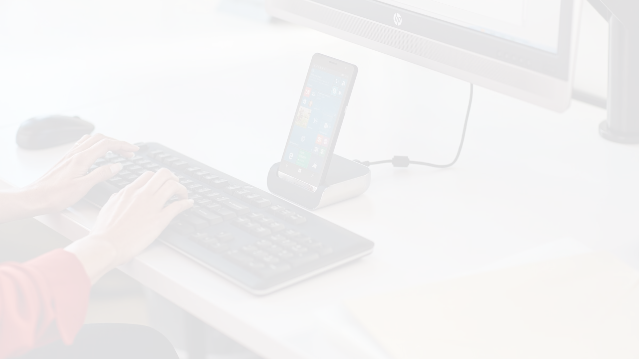
Manage Your Phone from Your Desktop
PlainApp is an open-source tool that lets you access your phone's files, contacts, media, and more from your computer's web browser.

Slide 3

Privacy-Focused Design
1
Secure Encryption
2
No Cloud Storage
TLS and AES-GCM-256 protect your data.
All data stays on your devices.
3
No Tracking
No activity monitoring or ad targeting.

Slide 4
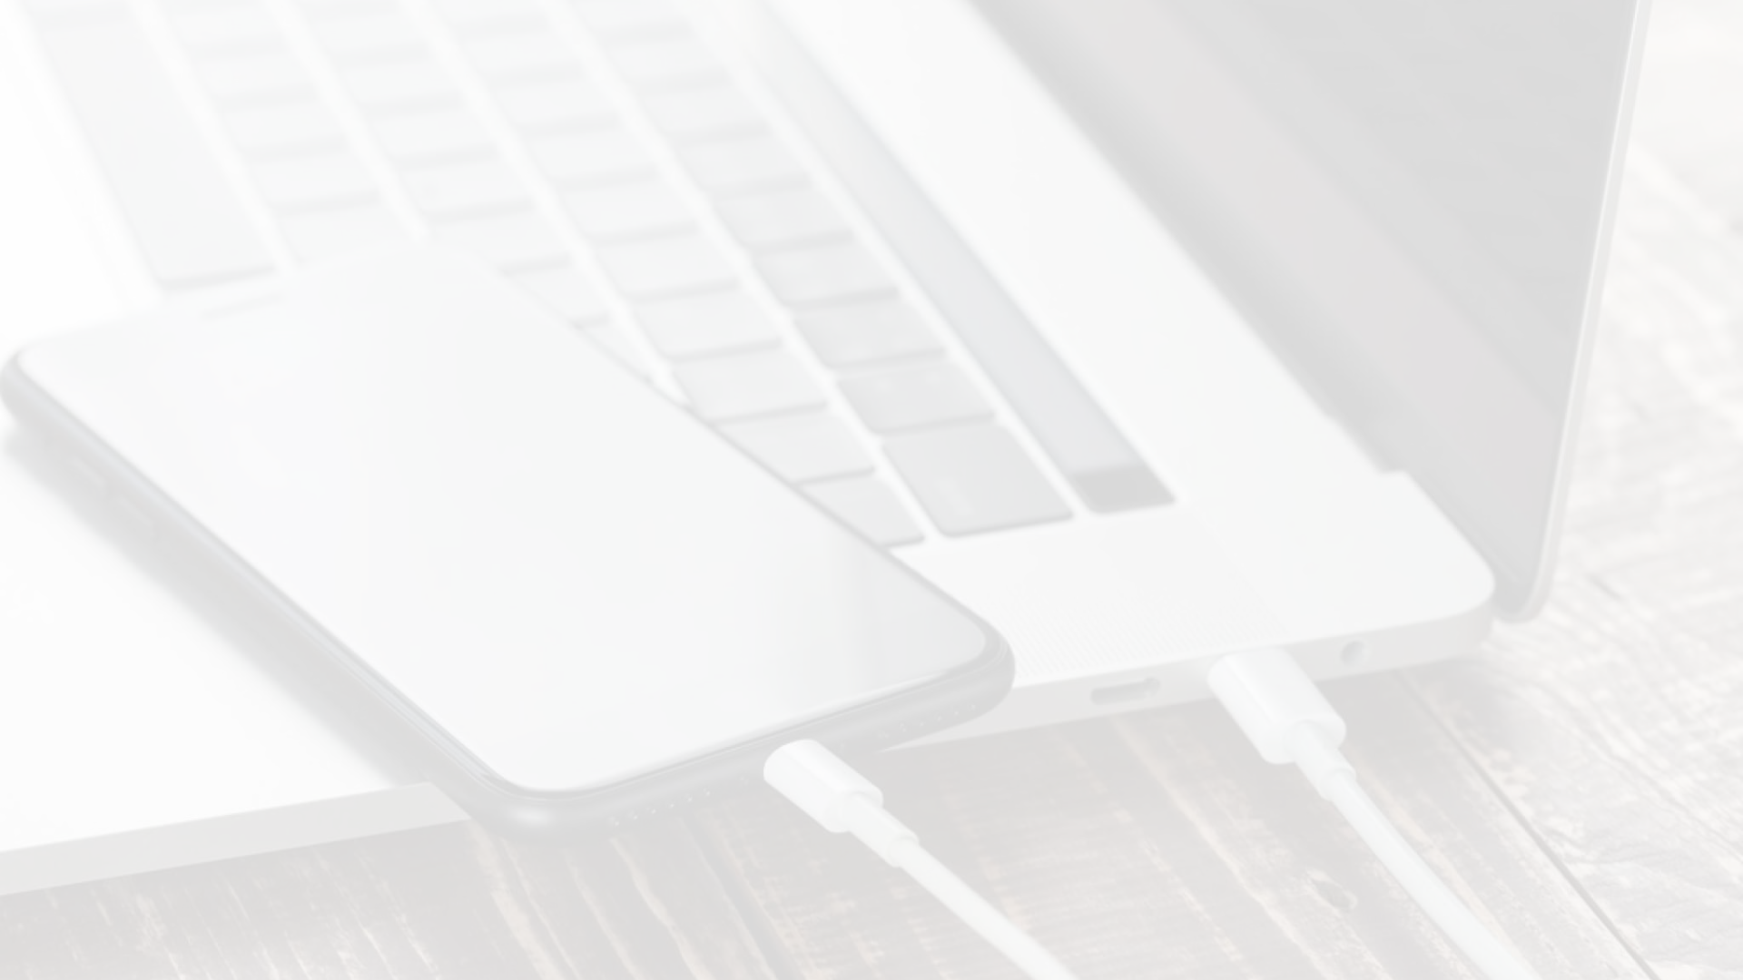
Manage Your Mobile Life
1
Files & Media
Access photos, videos, music, and more.
2
Contacts
Manage your contacts from your desktop.
3
Notes & RSS
Take notes and read news articles.

Slide 5





Powerful Capabilities
TV Casting
Backup & Export
Share media to your TV.
Safeguard your data.
Screen Mirroring
Handy Tools
View your phone's screen.
Includes a sound meter.

Slide 6

Benefits for Students & Teachers
Classroom Integration
Seamlessly connect phones and computers.
Mobile Organization
Manage files, contacts, and notes.
Multimedia Sharing
Display media on larger screens.
Productivity Boost
Streamline mobile and desktop workflows.

Slide 7




Designed for Minimalism
Focus on Essentials
Customizable Interface
No Bloat
Intentionally simple to avoid distraction.
Tailor the experience to your needs.
Only the tools you need, nothing more.

